Slide 1


ST. MARTIN’S ENGINEERING COLLEGE
UGC Autonomous
NBA & NAAC A+ ACCREDITED
Dhulapally, Secunderabad– 500100
Department of CSE (AI&ML)
THE IMPACT OF ARTIFICIAL INTELLIGENCE ON FORECASTING STARTUP SUCCESS OR FAILURE USING CRUNCHBASE DATA
BATCH NO: 05
B. Pavan Kumar (20K81A6607)
B. Sathvik (20K81A6606)
M. Sanjana (20K81A6625)
K. Santhoshi (20K81A6620)
Under the Guidance of
Mr. V. Sathish Goud
Associate professor
Department of CSE

Slide 2
OUTLINE
Abstract
Detailed Design
Representational Diagrams
Contribution of the candidate
Results Obtained
References
80% of Code
11-09-2023

Slide 3
ABSTRACT
Startups play a crucial role in driving innovation and economic growth, but they also encounter significant challenges, with a considerable proportion failing their initial years.
The traditional method of forecasting startup success or failure involves decision-makers relying on historical financial data, market analysis, and subjective evaluations of the founding team and business concept.
This project focuses on using AI to predict startup success or failure by analyzing data from Crunchbase, a comprehensive database of startup information.
Through AI, this system aims to revolutionize startup forecasting, providing valuable insights that empower all stakeholders involved in the startup ecosystem.
11-09-2023

Slide 4
Detailed Design
Data Acquisition :- Access and validate startup data from a reputable source like Crunchbase programmatically for accuracy.
Data Exploration :- Load the dataset in Python with Pandas, inspect its structure and content, address missing values, outliers, and anomalies, and visualize it using histograms and correlation heatmaps for insights.
Data Preprocessing :- Handle missing values, clean data (remove duplicates/irrelevant info), encode categorical variables, and normalize numerical features as needed before splitting the dataset into training and testing sets for modeling.
Feature Engineering :- Engineer impactful startup success predictors, incorporate domain expertise, and potentially apply feature selection techniques for dimensionality reduction and model enhancement.
11-09-2023

Slide 5
Detailed Design
Model Selection :- Select binary classification models (e.g., Decision Trees, Random Forests, Logistic Regression), evaluate their performance, and optimize via hyperparameter tuning using techniques like grid or random search.
Data Balancing :- Assess the class distribution to check for class imbalance . Apply techniques like SMOTE (Synthetic Minority Over-sampling Technique) to balance the dataset, ensuring better model performance.
Model Training:- Train the selected machine learning model(s) on the training dataset. Use appropriate evaluation metrics (e.g., accuracy, precision, recall, F1-score) to assess model performance.
Model Evaluation:- Assess model performance with the testing dataset, producing classification reports, confusion matrices, and relevant metrics, and visualize these metrics for clarity and presentation.
11-09-2023

Slide 6
Detailed Design
Interpretation and Deployment :- Interpret model outcomes, identify key success factors, create a summary report, and deploy the model if needed for practical application.
Documentation and Reporting :- Maintain thorough project documentation and generate a comprehensive report or presentation summarizing goals, methods, results, and recommendations.
Maintenance and Iteration :- Continuously update and retrain the model with new data for accuracy and iterate for performance enhancements.
Maintenance and Iteration :- Prioritize ethical data and model usage, addressing privacy and bias concerns with mitigation measures.
11-09-2023

Slide 7
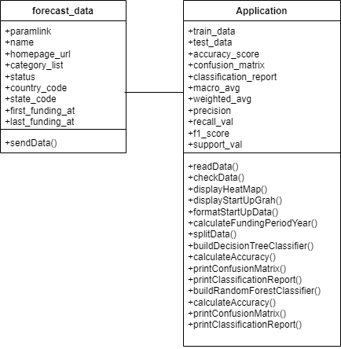
Representational Diagrams
Class Diagram: Class diagram is a static diagram. It represents the static view of an application.
11-09-2023

Slide 8
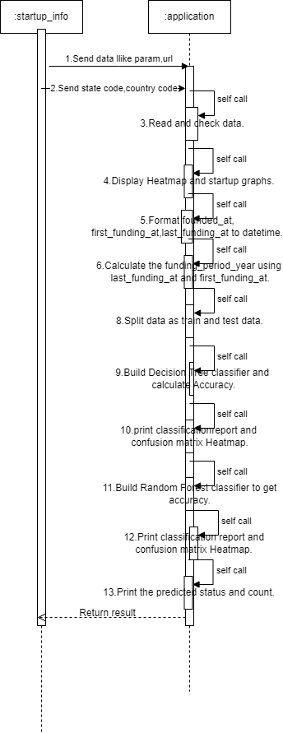
Representational Diagrams
Sequence Diagram : Sequence diagram is an interaction diagram that details how operations are carried out.
11-09-2023

Slide 9
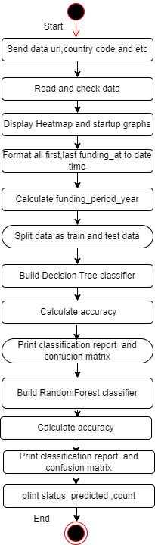
Representational Diagrams
Activity diagram : Activity diagram is another important diagram in UML to describe the dynamic aspects of the system.
11-09-2023

Slide 10
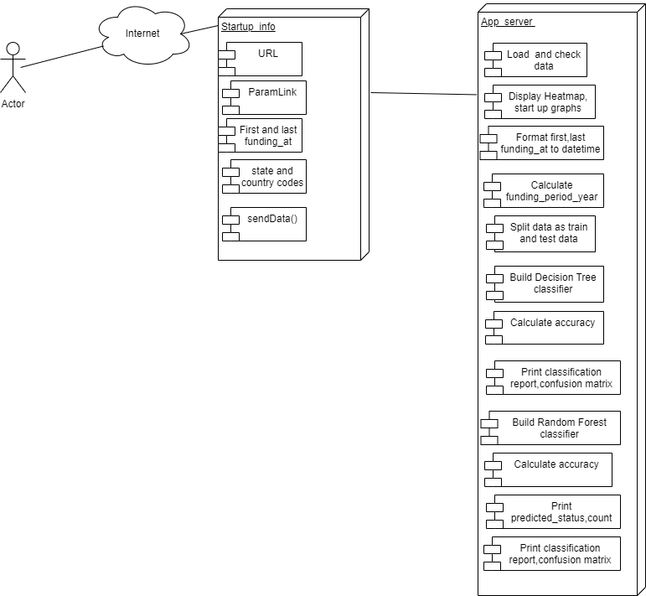
Representational Diagrams
Deployment diagram : The deployment diagram visualizes the physical hardware on which the software will be deployed.
11-09-2023

Slide 11
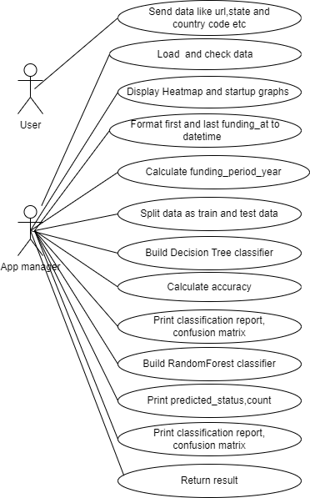
Representational Diagrams
Usecase diagram: The purpose of use case diagram is to capture the dynamic aspect of a system.
11-09-2023

Slide 12
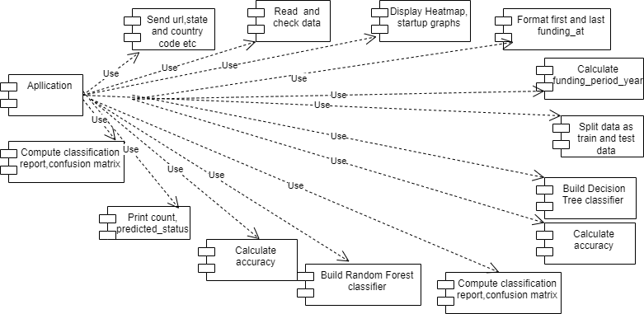
Representational Diagrams
Component diagram: Component diagram describes the organization and wiring of the physical components in a system.
11-09-2023

Slide 13
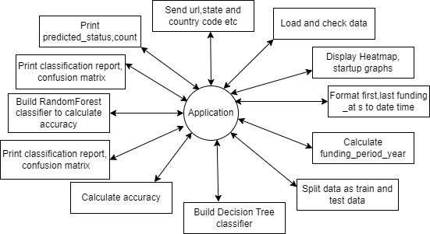
Representational Diagrams
DataFlow Diagram :A data flow diagram (DFD) is a graphical or visual representation using a standardized set of symbols and notations to describe a business's operations through data movement.
11-09-2023

Slide 14
CONTRIBUTION OF THE CANDIDATE
PAVAN
SATHVIK
Project Planning and Coordination
Data Acquisition
Model Selection and Training
Documentation and Reporting
Data Preprocessing
Data Visualization
Ethical Considerations
11-09-2023

Slide 15
CONTRIBUTION OF THE CANDIDATE
SANJANA
SANTHOSHI
Feature Engineering
Model Building
Model Evaluation
Data Balancing
Model Deployment
Cross-Validation
11-09-2023

Slide 16
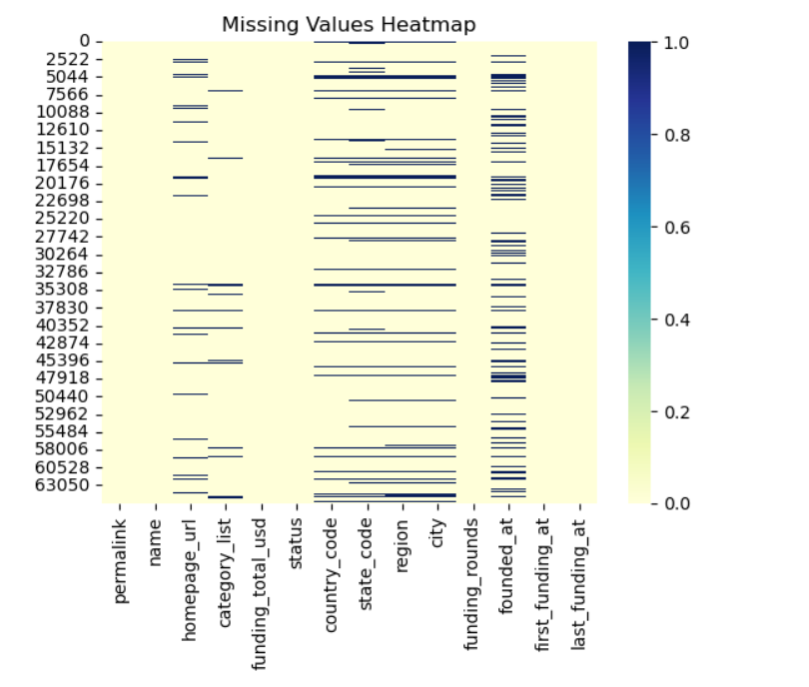
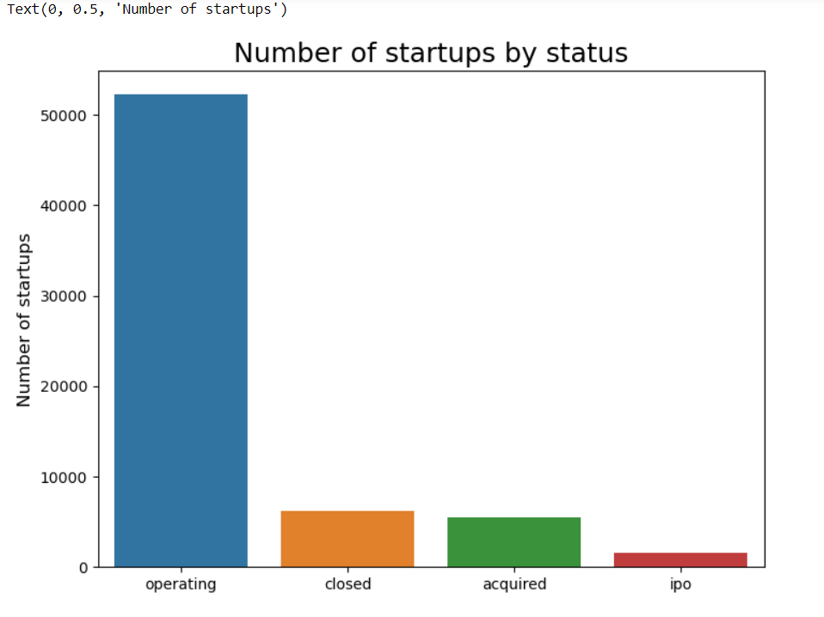
RESULTS OBTAINED
11-09-2023

Slide 17
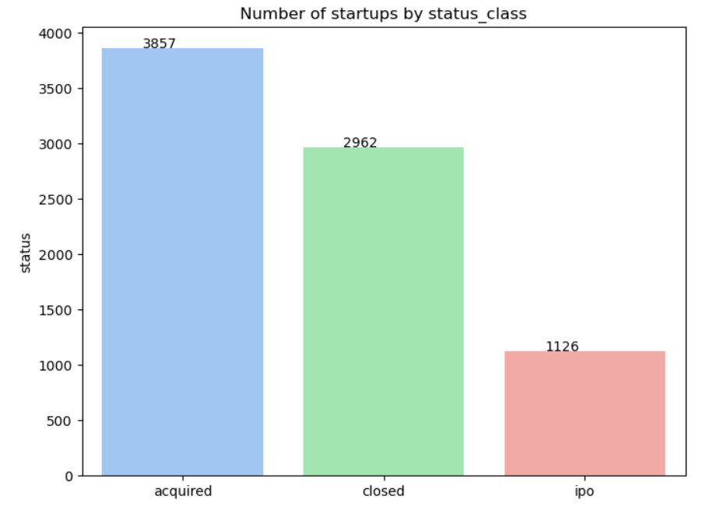
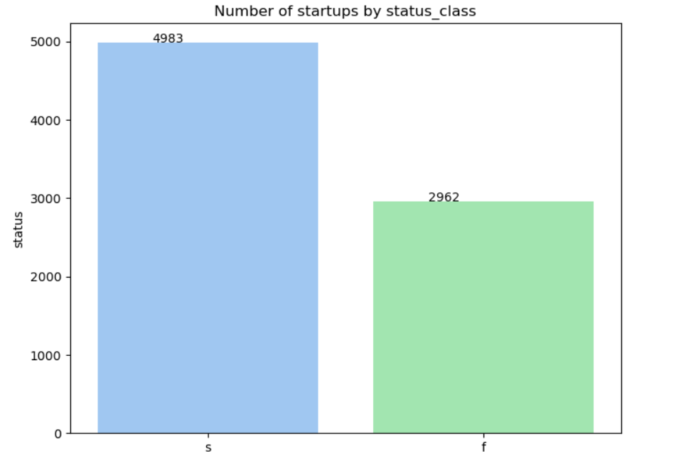
RESULTS OBTAINED
11-09-2023

Slide 18
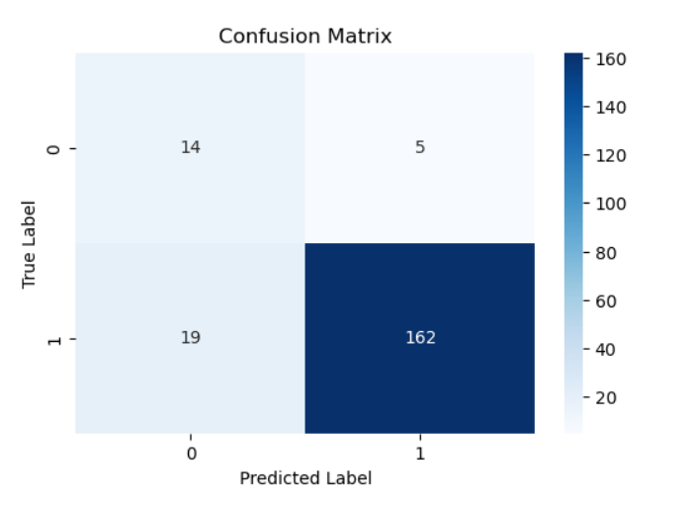
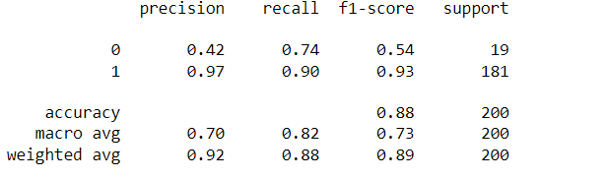
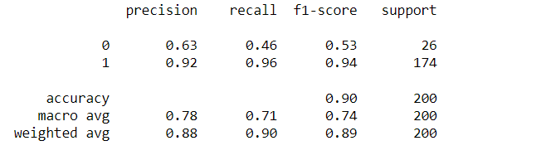
RESULTS OBTAINED
11-09-2023

Slide 19
REFERENCES
[1]. Huang et al., 2020 Huang W.-B., Liu J., Bai H., Zhang P. Value assessment of companies by using an enterprise value assessment system based on their public transfer specification Information Processing & Management, 57 (5) (2020), Article 102254, 10.1016/j.ipm.2020.102254.
[2]. Arroyo et al., 2019 Arroyo J.Corea F. Jimenez-Diaz G., Recio-Garcia J.A.Assessment of machine learning performance for decision support in venture capital investments IEEE Access, 7 (2019), pp. 124233-124243
[3]. Fraiberg, 2017 Fraiberg S. Start-up nation: Studying transnational entrepreneurial practices in Israel’s start-up ecosystem Journal of Business and Technical Communication, 31 (3) (2017), pp. 350-388.
11-09-2023

Slide 20
REFERENCES
[4]. Dellermann et al., 2017 Dellermann, D., Lipusch, N., Ebel, P., Popp, K. M., & Leimeister, J. M. (2017). Finding the unicorn: Predicting early stage startup success through a hybrid intelligence method. In International Conference on Information Systems.
[5]. Krishna et al., 2016 Krishna A., Agrawal A., Choudhary A. Predicting the outcome of startups: less failure, more success2016 IEEE 16th international conference on data mining workshops, IEEE (2016), pp. 798-805
[6]. Engel, 2014Engel J. Global clusters of innovation: Entrepreneurial engines of economic growth around the world Edward Elgar (2014)
11-09-2023

Slide 21
REFERENCES
[7]. Fielding and Reschke, 2014 Fielding R., Reschke J. Hypertext transfer protocol (HTTP/1.1): semantics and content RFC Editor (2014)
[8]. Harris et al., 2014 Harris R.S., Jenkinson T., Kaplan S.N. Private equity performance: What do we know? The Journal of Finance, 69 (5) (2014), pp. 1851-1882.
[9]. Bergstra and Bengio, 2012Bergstra J., Bengio Y. Random search for hyper-parameter optimization Journal of Machine Learning Research, 13 (2012), pp. 281-305
11-09-2023

Slide 22
REFERENCES
[10]. Bonardo et al., 2010Bonardo D., Paleari S., Vismara S. The M&A dynamics of European science-based entrepreneurial firms The Journal of Technology Transfer, 35 (1) (2010), pp. 141-180.
[11]. Cawley and Talbot, 2010Cawley G.C., Talbot N. L. On over-fitting in model selection and subsequent selection bias in performance evaluation Journal of Machine Learning Research, 11 (2010), pp. 2079-2107.
[12]. Lee, 2013Lee A. Welcome to the unicorn club: Learning from billion-dollar startups Cowboy Ventures (blog) (2010).
11-09-2023

Slide 23
REFERENCES
[13]. Amin and Kat, 2003Amin G.S., Kat H.M.Welcome to the dark side: Hedge fund attrition and survivorship bias over the period 1994–2001The Journal of Alternative Investments, 6 (1) (2003), pp. 57-73
[14]. Ber and Yafeh, 2007Ber H., Yafeh Y. Can venture capital funds pick winners? Evidence from pre-IPO survival rates and post-IPO performance Israel Economic Review, 5 (1) (2003), pp. 23-46.
[15]. Cooper, 1993Cooper A.C. Challenges in predicting new firm performance Journal of Business Venturing, 8 (3) (1993), pp. 241-253, 10.1016/0883-9026(93)90030-9.
11-09-2023

Slide 24
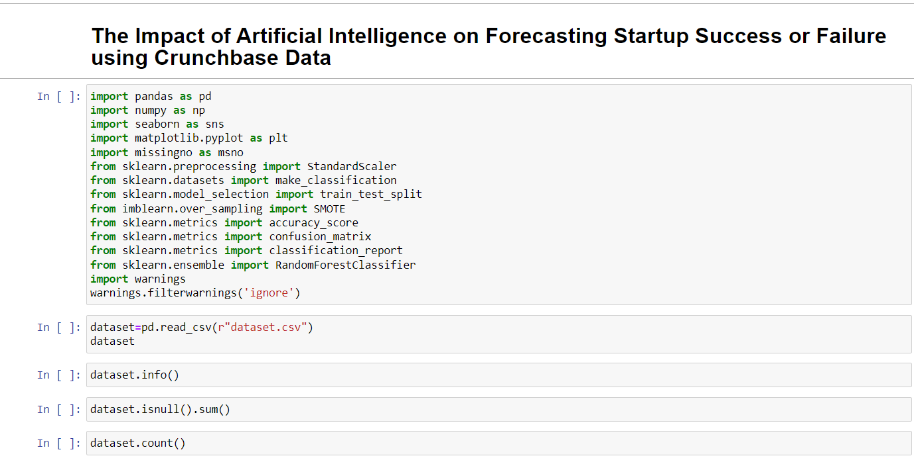
80% CODE
11-09-2023

Slide 25
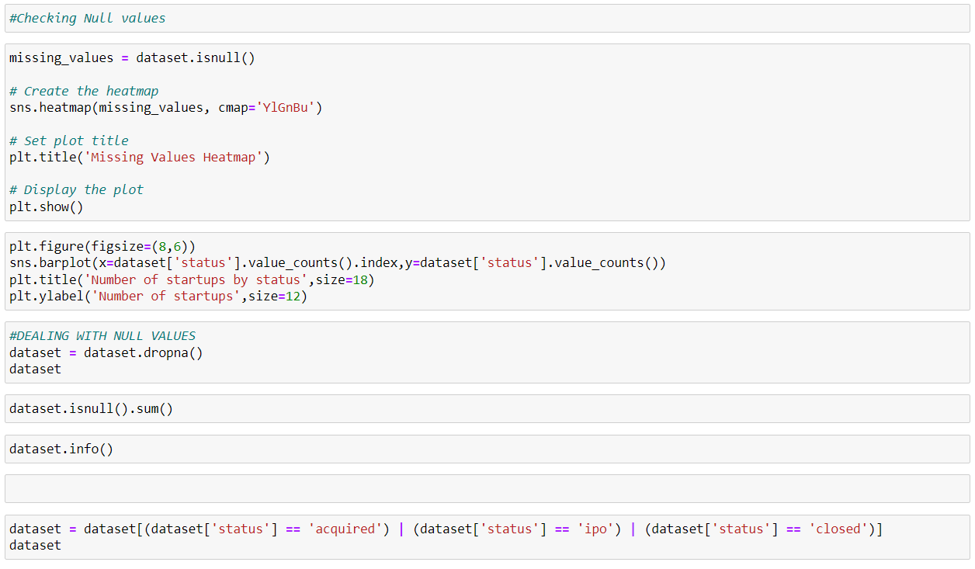
80% CODE
11-09-2023

Slide 26
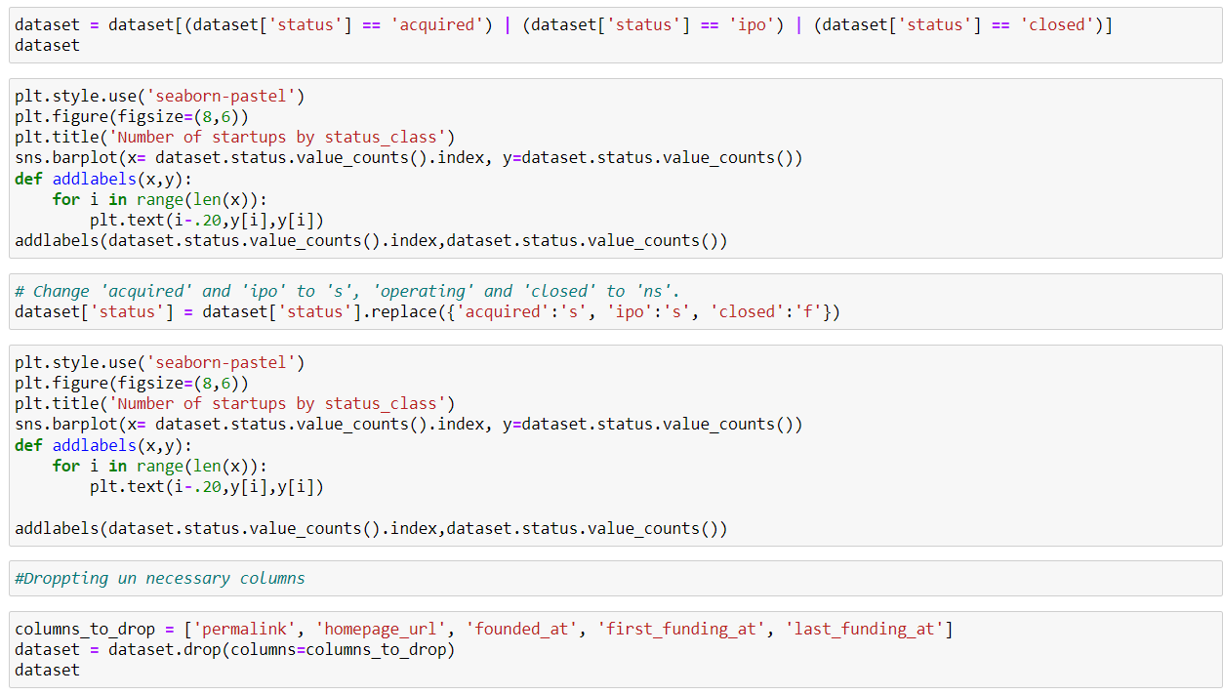
80% CODE
11-09-2023

Slide 27
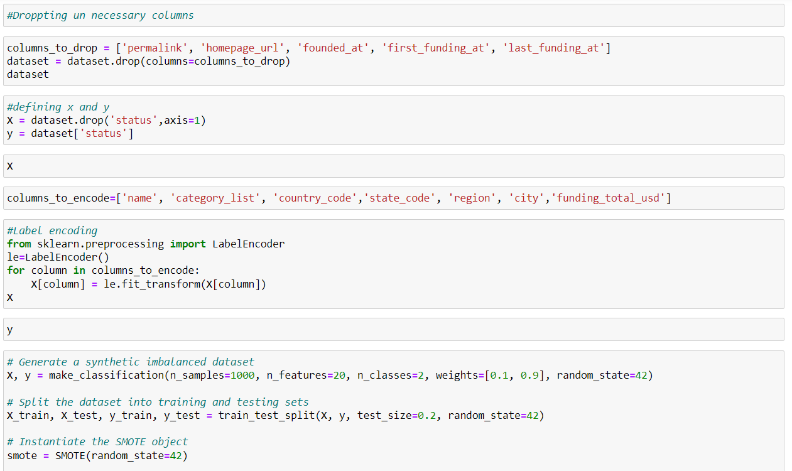
80% CODE
11-09-2023

Slide 28
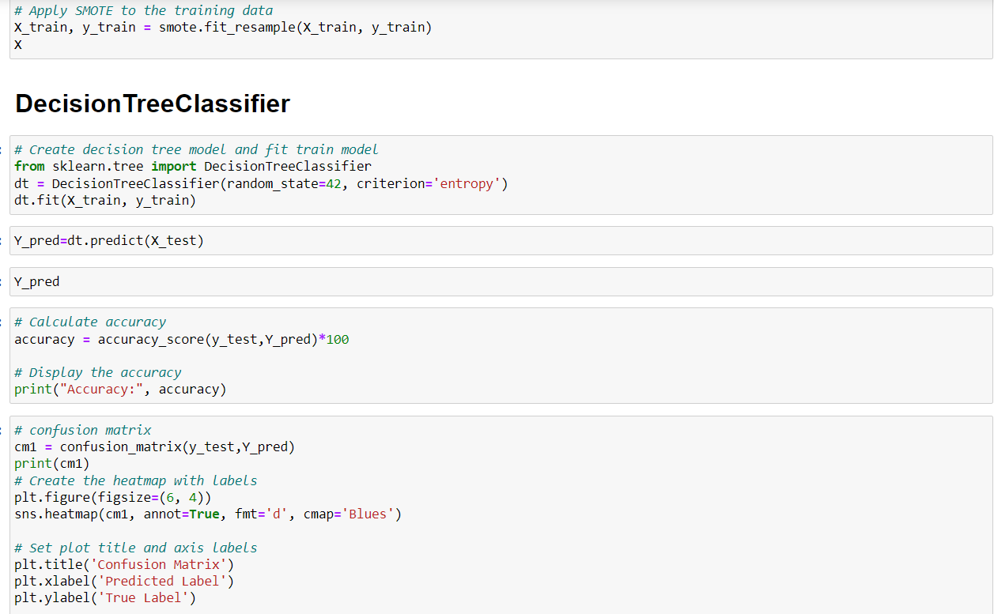
80% CODE
11-09-2023

Slide 29
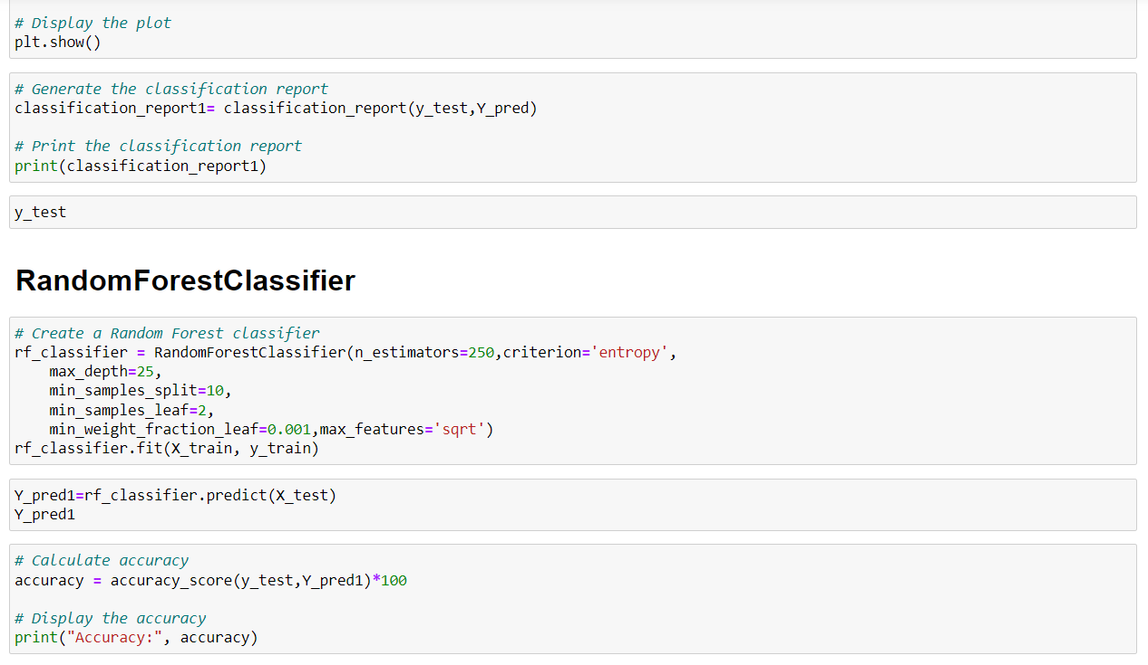
80% CODE
11-09-2023

Slide 30
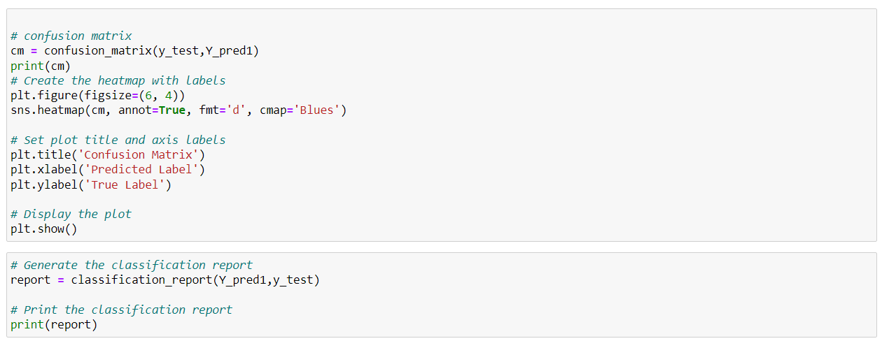
80% CODE
11-09-2023

Slide 31
QUERIES ??
11-09-2023

Slide 32
THANK YOU
11-09-2023

